Slide 1
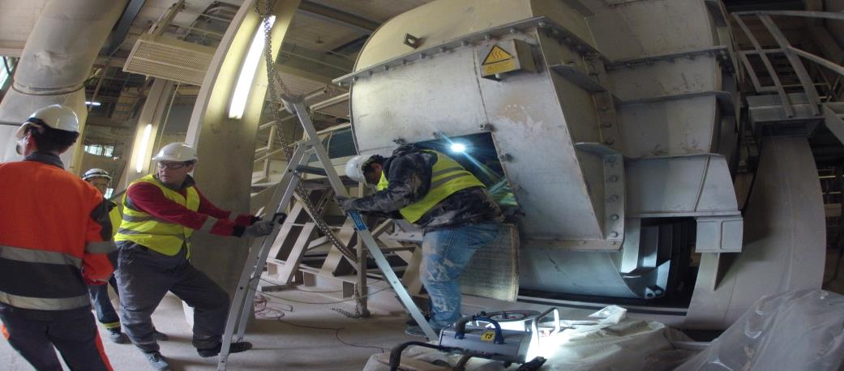
Process Fans
Technical Development Program for Process Performance Engineers – SPREAD 2106
Mirko Weber

Slide 2
FAN Initiative “FANi” in exHolcim - Background
Large process fans are responsible for about 30-50% of the electrical energy consumption in cement plants.
Experiences in the past and actual measurements have shown that fans often run below the expected fan efficiency of 75-85%.
Besides fan efficiency, the power consumption is proportional to the flow in a fan system, therefore any source of undesired flow (i.e. false air intakes) shall be fixed.
Expected benefit if 1% efficiency increase per main fan: 30 million USD by fan performance optimization
Further economical benefits by:
Increased production capacity in sold-out markets
Increased AFR utilization potential group wide

Slide 3
Agenda
Fan Basics
3
Fan Efficiency
19
Fan Assessment
28
Fan Issues and Maintenance
45
3

Slide 4
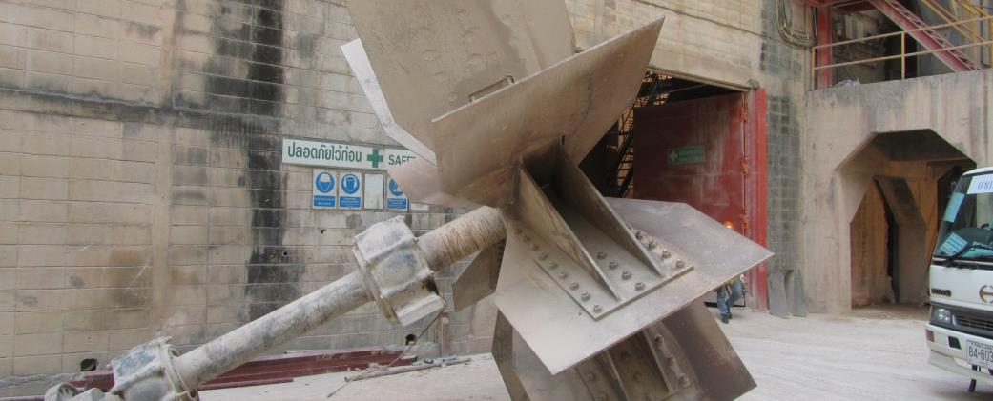
Technical Development Program for Process Performance Engineers 2015
Fan Basics
Fan and Plant Characteristic
VSD vs. Fixed Speed
Flow Phenomena
4

Slide 5
Fan and Plant Characteristic
The fan operates at the crossing point of plant and fan characteristic
Δp
P
fan characteristic
plant characteristic
P_{D}
p_{D}
design point
fan characteristic
V_{D}
Vact

Slide 6
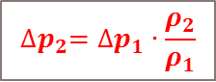
Gas Density Impact (1/2)
Δ
The fan curve is a result of the fan geometry, at a given gas density and fan speed
p
ρ_{reference} ≠ ρ_{actual}
$${∆p}_{2}={∆p}_{1}∙\frac{ρ_{2}}{ρ_{1}}$$
Fan characteristic
Design point
Δp_{D}
ρ_{actual} < ρ_{reference} ➔ fan capacity reduction
Δp_{D,real}
Same fan speed
V
V_{D}

Slide 7
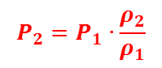
Gas Density Impact (2/2)
P
The power curve depends also on the gas density
$$P_{2}=P_{1}∙\frac{ρ_{2}}{ρ_{1}}$$
Design point
fan characteristic
P_{D}
P_{D,real}
V
V_{D}

Slide 8
Control Methods: Variable Speed Fan (VSD)
To reach the set point (operating point) the fan speed can be modified → shifting the fan characteristic
Δ
p
plant characteristic
design point
operating point
fan characteristic
p_{O}
reduced fan speed
100% fan speed
V
V_{O}

Slide 9
Fan Characteristic: Fan Speed Impact (VSD)
volume flow
static pressure
power requirement
first approach, as equations do not consider changes in density, compressibility and efficiency
9

Slide 10
Control Methods: Fixed Speed Fan
Δ
p
To reach the set point (operating point) the gas flow has to be throttled by a damper → tilting the plant characteristic
plant characteristic
p_{O}
design point
additional Δp by throttle
operating point
fan characteristic
100% fan speed
V
V_{O}

Slide 11
Power Consumption: VSD vs. Fixed Speed
Remember for VSD:
Δp
plant characteristic
design point
operating point
fan characteristic
p_{O}
reduced fan speed
power required with VSD
100% fan speed
v_{O}
v
V
11

Slide 12
Power Consumption: VSD vs. Fixed Speed
Additional Δp leads to increased power consumption
Δp
VSD fans are much more efficient than fixed speed fans
plant characteristic
p_{O}
design point
power required with fixed speed fan
additional Δp by throttle
operating point
fan characteristic
power required with VSD
100% fan speed
v_{O}
v
V
12

Slide 13
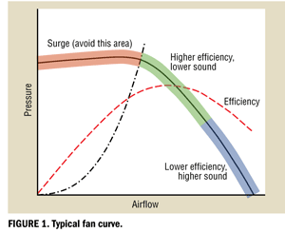
Fan Flow Phenomena
Almost no fan can provide the desired continuous, steady flow over the full range of volume flow, pressure and rotating speed
If your fan shows the following symptoms
oscillation/variation of flow and pressure
increased noise and/or vibration levels
increased gas temperature difference between fan inlet and outlet
reduced efficiency
Most likely one of the known flow phenomena occurs
surge
stall
…
13

Slide 14
Surge
The fan should always be operated right of the fan curve peak pressure
Increasing flow → pressure capacity decreases
Safety margin: operate at minimum 110% “peak pressure”-flow
If the fan is operated left of the fan curve peak pressure:
with increasing flow also the pressure capacity increases
the energy imparted to the gas alternates between a) creating kinetic energy (increased flow and velocities) b) potential energy (compressing the gas)
the operating point is not defined
Δp
surge limit
range of operation
v
14

Slide 15
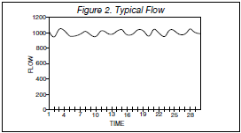
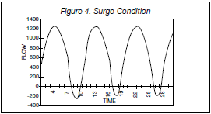
Surge
15

Slide 16
Surge
Effects of surging
variation in fan delivery pressure
variation in volume flow => the fan is pumping
even flow oscillation => the fan volume flow gets “negative”; the flow is exiting the fan inlet
high heat generation => the fan efficiency significantly decreases
increased noise generation => might sound like “whoosh” or “whoomp”
increased vibrations => structural fatigue damage to the fan => damage to ductwork and other system components
The fan is not suitable for this operating point
16

Slide 17
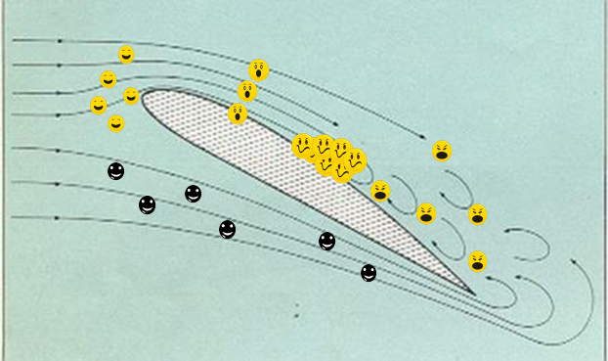
Stall
The higher the fan outlet pressure, the more dense is the gas
Gas fluid particles experience this like a “traffic jam”
particles are forced to stop => the fan volume flow suddenly decreases
then again there is room to move => the fan volume flow suddenly increases again
some particles are forced to make a detour, leaving their ideal trajectory => this needs extra energy and makes the traffic jam even worse
some particles are forced to break away, stop, go back and queue again => this recirculation drastically reduces the fan volume flow, eventually more particles are going back than forth
particle crashes and friction between particles are unavoidable => heat generation, vibration and a increased noise level are the consequences
17

Slide 18
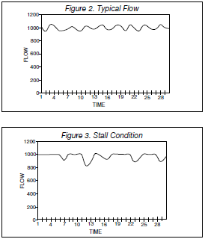
Stall
18

Slide 19
Stall
Effects of stalling
variation in fan delivery pressure => the pressure falls off
variation in volume flow => the fan is pumping
even flow oscillation => the fan volume flow gets “negative”; the flow is exiting the fan inlet
high heat generation => the fan efficiency significantly decreases
dramatic noise generation => might sound like solids are hammering the blades => the fan efficiency significantly decreases
significant vibrations => structural fatigue damage to the fan => damage to ductwork and other system components
19

Slide 20
Common Effects of Surge and Stall
There are common effects and influences
variation in fan delivery pressure → the pressure falls off
variation in volume flow → the fan is pumping
flow oscillation → fan volume flow might become “negative”, is exiting the fan inlet
high heat generation → the fan efficiency significantly decreases
dramatic noise generation → sounds like “whoosh” (Surge) or like solids are hammering the blades (Stall)
significant vibrations → structural fatigue damage to the fan → damage to ductwork and other system components
Counteraction: increase flow / change operating point!

Slide 21
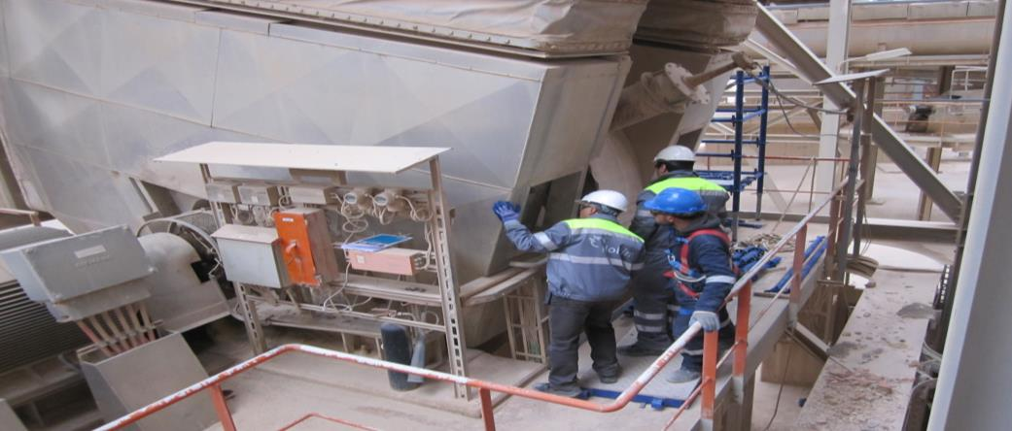
Technical Development Program for Process Performance Engineers 2015
Fan Efficiency
Definitions
Impact of Dust
Impeller Types
21

Slide 22
Power Consumption of Fan System
BLACK BOX
22

Slide 23
Power Consumption of Fan System
23

Slide 24
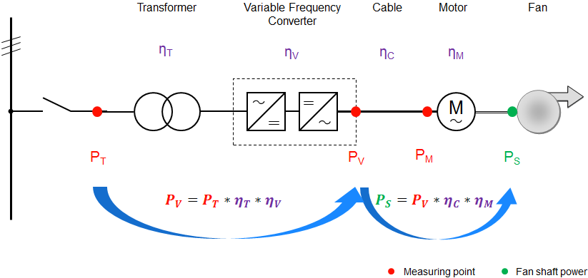
Calculation of Shaft Power Requirement
Δp
Typical values:
η_{Transformer} = 99.0%
η_{VSD} = 97.5%
η_{Cable} = 99.5%
η_{Motor} = 96.5%
η_{Coupling} = 100%
P
P
P_{shaft} ≠ P_{Measured}
Δp
V
V

Slide 25
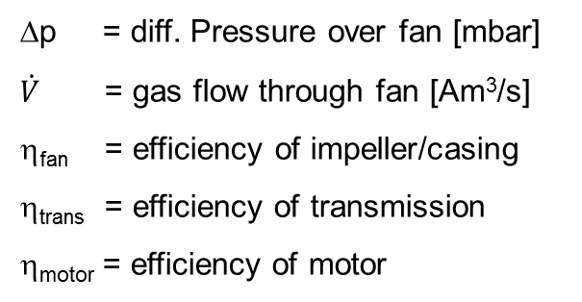
Power consumption – some definitions
Shaft power (as calculated process-wise)
Total power (as measured electrically)
25

Slide 26
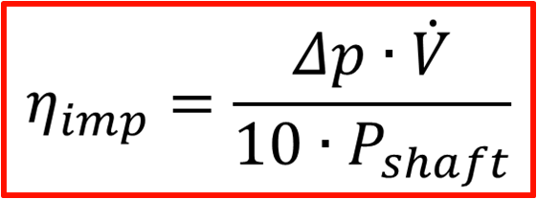
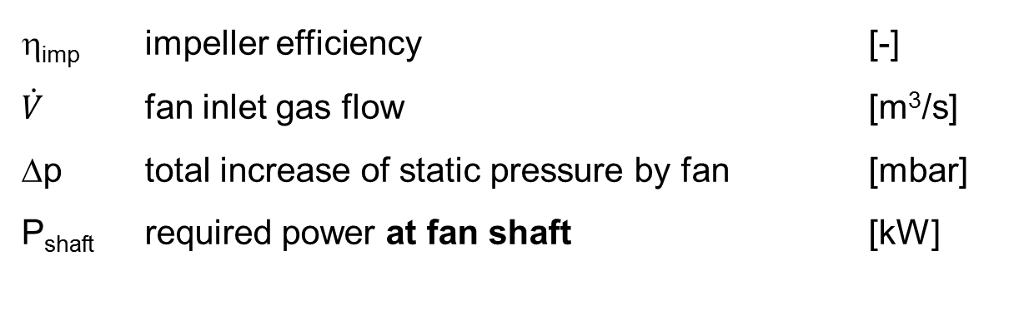
Fan Efficiency
in case of significant dust load additional shaft power to be considered
for detailed calculation application of fan tool recommended
26

Slide 27
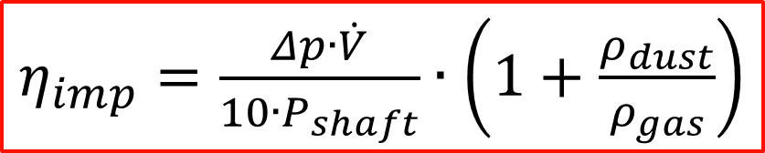
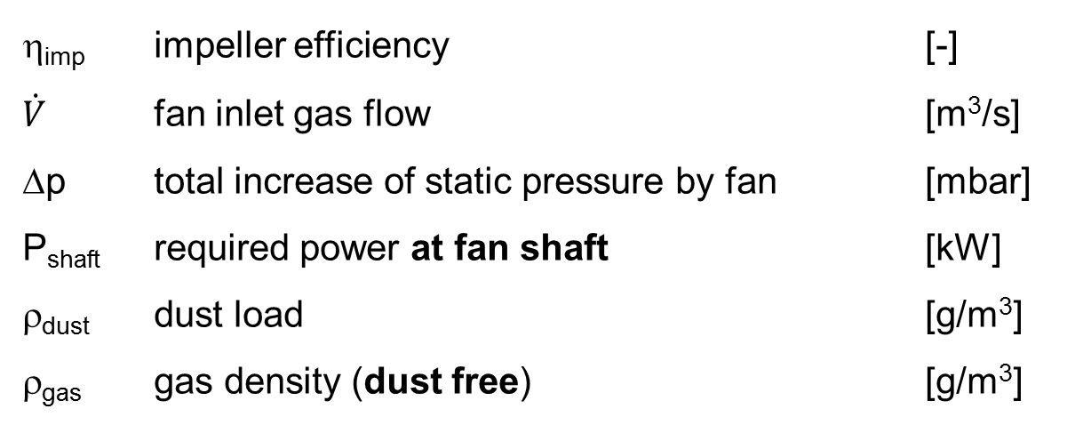
Fan Efficiency with Dust Impact
27

Slide 28
Fan Efficiency Field
The fan efficiency η is typically at the optimum near design point
With VFD the efficiency field moves with shifting the fan characteristic, such the fan efficiency is high in a wide operating range
design point
p_{D}
operating point
fan characteristic
p_{O}
reduced fan speed
100% fan speed
V_{O}
V_{D}

Slide 29
Impeller Types, Efficiency and Dust Load
29

Slide 30
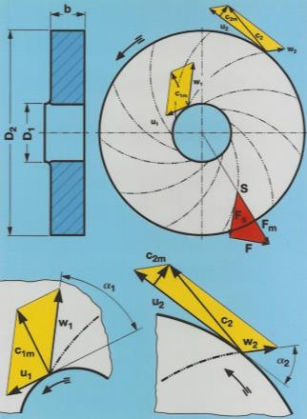
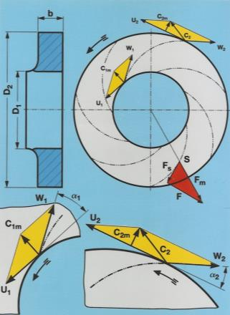
Efficiency vs. Build-Up Risk
steep blades (large β1, β2)
lower efficiency
lower build-up risk
flat blades (small β1, β2)
higher efficiency
higher build-up risk
β1
β1
β2
β2
30

Slide 31
Fan Efficiency Tool (FET) and Fan Benefit Calculator (FBC)
https://sites.google.com/a/holcim.com/cp-internal-training-work-site/

Slide 32
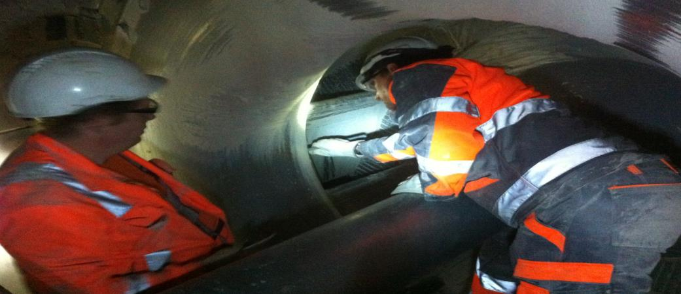
Technical Development Program for Process Performance Engineers 2015
Fan Assessment
The Fan Assessment Process
Tools
Selection of Measuring Points
Required Process Data
Fan Inspection
32

Slide 33
What is a Fan Assessment
Complete study of process fan performance
Fan Performance
Mechanical Condition
Proposals for improvement (if necessary)
Process
Maintenance
CAPEX
Results verification
33

Slide 34
When to perform a Fan Assessment
Suspicion of sub-normal operation
Higher power consumption
High vibrations
Reduced gas handling capacity
Need to know equipment limits
Bottleneck analysis
Upgrade projects
34

Slide 35
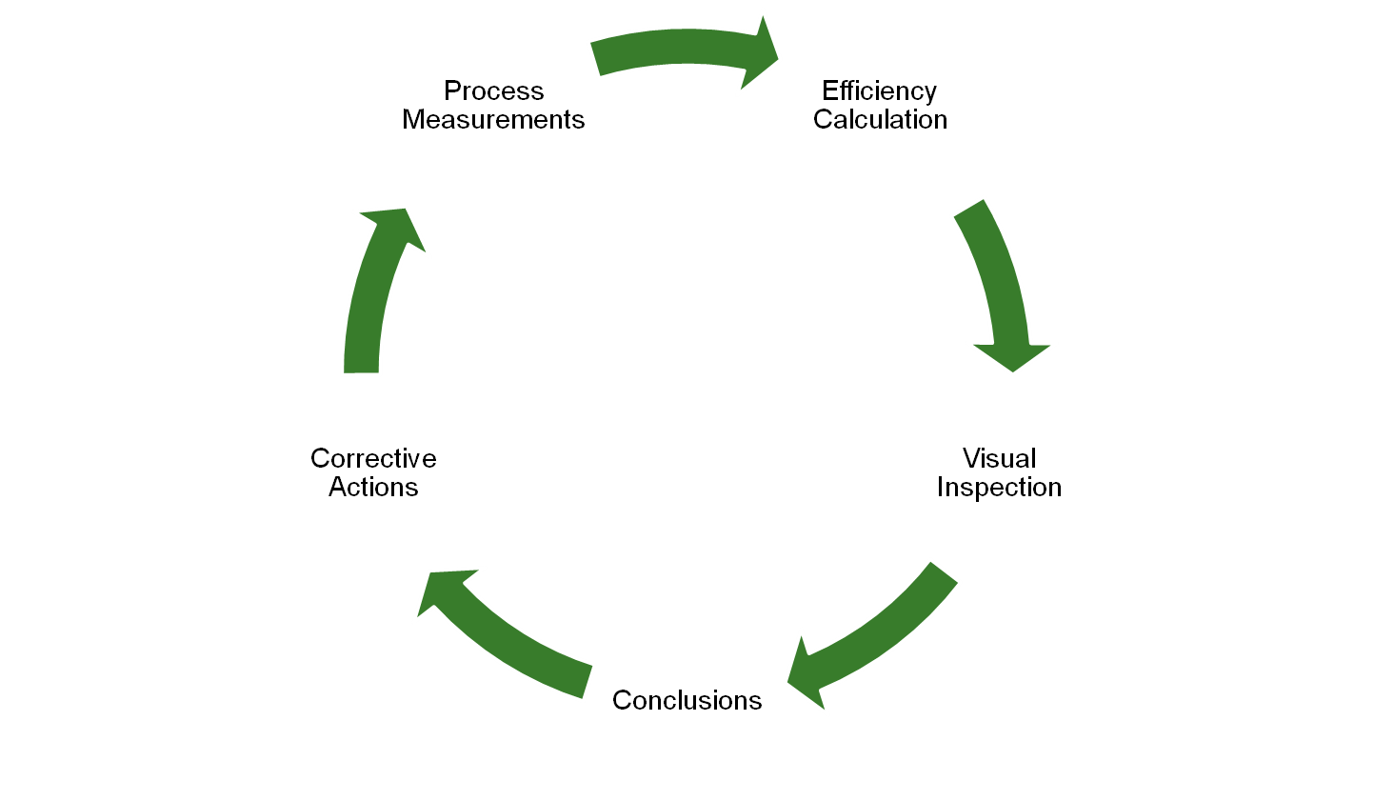

Fan Assessment Process:
Pre work
35

Slide 36
Fan Assessment Process: Steps (1/3)
Before field work:
H&S !
Documentation gathering
Fan curves + Reference conditions
Fan drawings (Impeller, inlet cone, casing)
Arrangement drawings / pictures (Inlet & outlet ducting, installation…)
…
Selection of the best flow measurement location and instruments
Measuring ports checking and installation
Remember: Wrong documentation will lead to wrong conclusions!
36

Slide 37
Fan Assessment Process: Steps (2/3)
Field work:
Process Measurements:
Volume flow at fan inlet or outlet (both if possible, consider false air!)
p at fan inlet and outlet
T at fan inlet and outlet
Power consumption & fan speed
Visual inspection:
Blades condition (thickness, length, deformation, wear…)
Inlet cone penetration
Cone – Impeller Gap
Build-ups (take pictures, take samples, hard/soft?)
Check for over-heating or corrosion signs (also on the casing)
Remember: Wrong measurements will lead to wrong conclusions!
37
Guide value to be provided by fan supplier

Slide 38

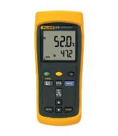
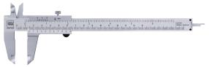
Tools
Hardware
Camera
Manometer (with data logger)
Thermometer (with data logger)
Gauge / Measuring tape
Flow measurement devices
Prandtl / Pitot
Promecon
Anemometer
Software
Fan Efficiency Tool (FET)
TIS-FET
Anemometer and Prandtl Tube Measurements Spreadsheet
38

Slide 39
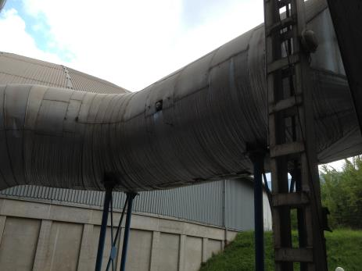
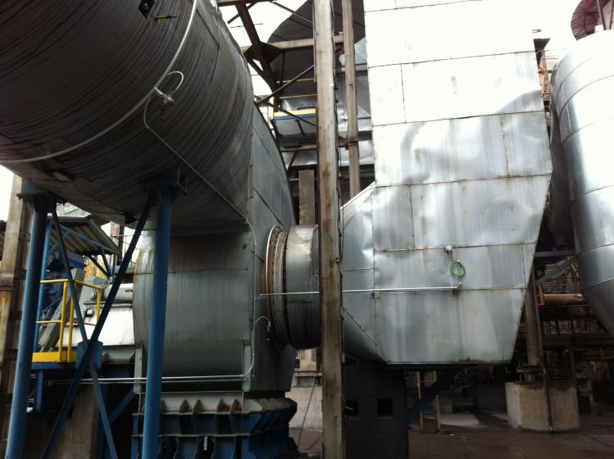
Field Work: Selection of measuring points
3*D
Ideal:
Straight distance 5*D before and 3*D after
no obstruction, joint or change in gas path
At least two openings at 90° (better four for large ducts)
Safe and easy access
Temperature gauge
Pressure gauge
39

Slide 40
Measuring ports
Pressure Measurement
To Pressure Sensor
Squared duct
Pipe
Round duct
40

Slide 41
Field Work: Process data - Example
Measured Values:
Fan Speed (taken from CCR)
P (at VSD, taken from CCR)
V_{inlet} (e.g. Prandtl tube)
P_{inlet/}P_{outlet}
T_{inlet}/T_{outlet}
Recommendation
Crosscheck measured flow!
Measure at inlet and outlet
Consider false air from measuring point(s) to fan inlet/outlet
41

Slide 42

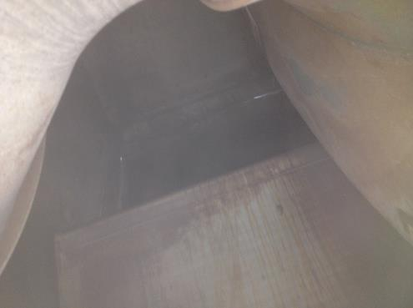
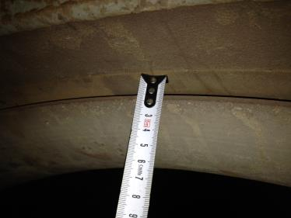
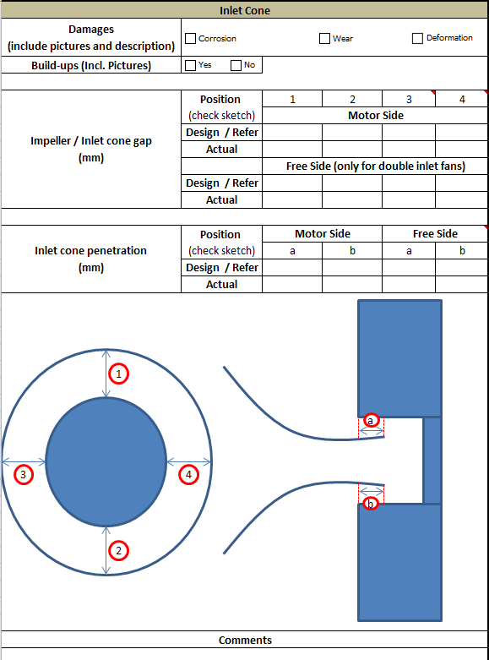
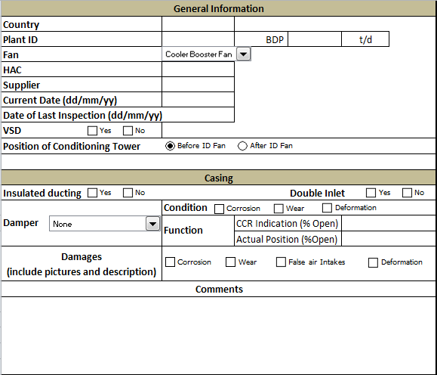
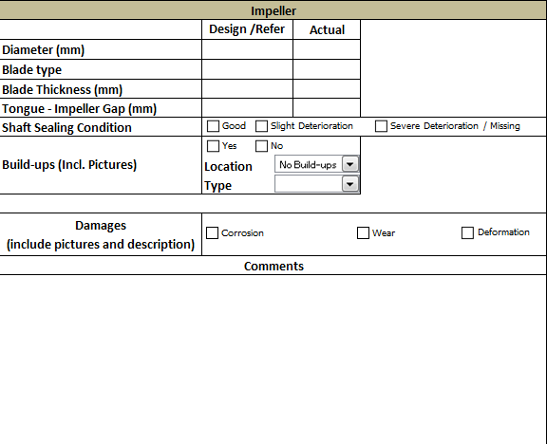
Fan Inspection
Inspection
Casing – specification and conditions
Inlet cone - impeller gap and cone penetration
Impeller conditions (wear, deformation…)
Document your findings!
42

Slide 43
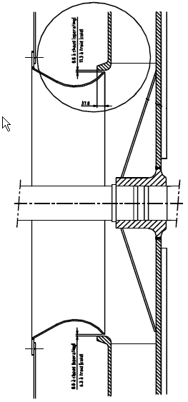
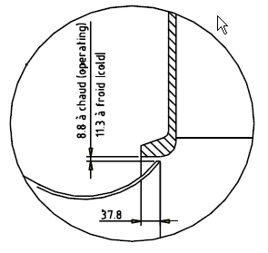
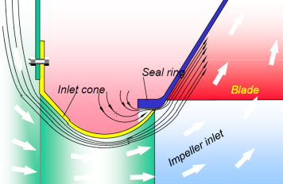
Inlet Cone Inspection
Cone / Impeller gap
Specific value given by supplier
General reference: 7.5 mm (for impellers bigger than 2m)
Cone penetration
Specific value given by supplier
General reference: 25 – 50 mm
43

Slide 44

Fan Gap Management
Correct fan inlet cone radial (gap) and axial placement (penetration) is crucial for high fan performance / efficiency by creating
a laminar flow at fan inlet
a recirculation
During maintenance adjust fan gap
according supplier specification
considering thermal expansion
Source: Howden
44

Slide 45
Fan Assessment Process: Steps (3/3)
Desk work:
Measurement data compilation
Fan efficiency calculation
Data comparison (check next slides)
η_{Expected} = η_{Calculated}?
P_{Expected} = P_{Measured}?
V_{Eexpected} = V_{Measured}?
Conclusions
Match visual inspection with measured / calculated data
Corrective actions
Get aligned with maintenance department
Remember: Performance will only improve if you work as a team with maintenance!
45

Slide 46
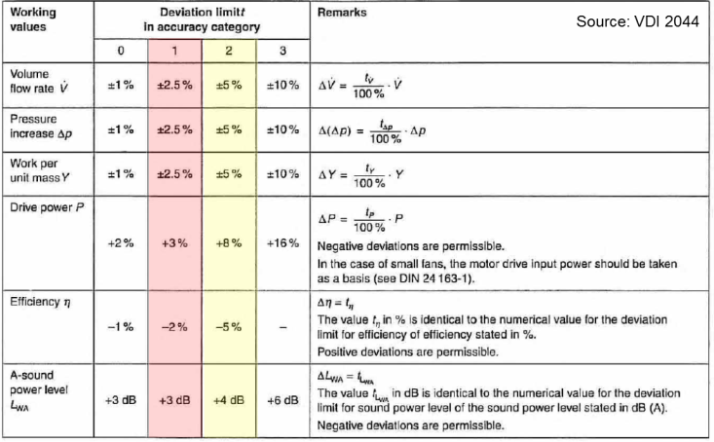
Fan Accuracy Classes
Accuracy Category 1: Holcim standard
Accuracy Category 2: in case of insufficient indications
46

Slide 47
Fan Accuracy Classes
Consider impact of chosen accuracy class for Fan Guarantee & Performance Test
Acceptable
- Measurement uncertainty
- Accuracy class tolerance
Δp
Not Acceptable
plant characteristic
design point expected performance
p_{D}
fan accuracy
measurement accuracy
fan characteristic
100% fan speed
to be accepted
measured point
v_{D}
v
47

Slide 48
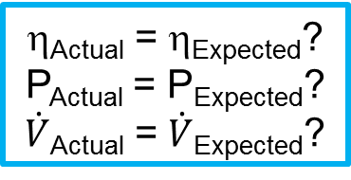
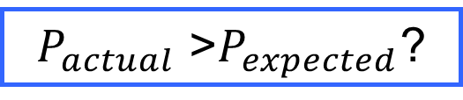
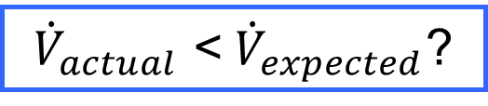
Fan Assessment
YES
NO
GOOD!
Check
Motor η
Damper Position
Build-ups?
Check
Impeller
48

Slide 49
Fan Inspection
Check the Fan Inspection Video
https://drive.google.com/a/holcim.com/file/d/0B6fe5NZGsbbYYXFRcG01QnNTbEU/view?usp=sharing

Slide 50
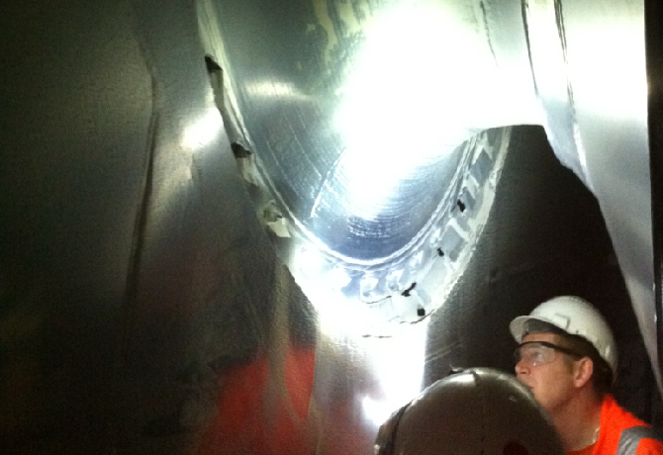
Technical Development Program for Process Performance Engineers 2015
Fan Issues and Maintenance
Workshop Inspection
Peak Temperature and Interlock
Fan Brakes
Wear and Wear Protection
Build-up, Vibrations and Cleaning
Modification and Replacement
50

Slide 51
Workshop Inspection of New Fan
Quality assessment of a main process fan has to be carried out at Workshop before assembling of impeller and shaft
visual inspection
magnetic particle test of impeller and shaft
ultrasonic inspection of shaft
hardness test on shaft
materials check
dimensions check
verification of welding and heat treatment (if applicable)
review of documents and certificates
balancing test
Caution! Workshop inspection is crucial to ensure that we get what we pay
51

Slide 52
Fan Peak Temperature & Interlock
Common sense (and physics) says: a) T_{gas, expected} ≤ T_{fan, 100% time} < T_{fan, short time} <T _{fan, peak = max} b) gas temperature UP ➔ fan lifetime DOWN
Never accept a fan without written (signed) datasheet including:
Peak temperature, which never shall be exceeded
Temperatures the fan can be operated for short periods (up to 10 minutes)
Implement / adjust fan interlock to protect fans and people
Never override a safety interlock!
Consider and check measures to prevent fan overheating
Emergency fresh air
Water injection
52

Slide 53
Fan Brake
How to slow down/stop the fan faster to get sooner access for inspection and maintenance? How to prevent the fan from turning while doing inspection and maintenance (H&S)?
Electrical Brake
only possible with “4 quadrant drive VFD“-type
however, due to power-off / lock-out during maintenance even this VFD cannot be used for preventing fan rotation
Mechanical Brake
wait until fan stopped, then prevent rotation by blocking the impeller with wooden beams
do not brake the fan by pressing a wooden beam against the fan shaft (H&S)
better: install mechanical fan brake
53

Slide 54
Erosion and Wear
High fan speed is the most important driver for Wear on Blades
wear varies in the second up to third power of the speed of a particle that hits the blade
Erosion / Wear Root Causes
corrosion
abrasive dust
high fan speed and high fan inlet velocity
blade-hitting gas/particle flow due to duct/fan design
inappropriate blade shape and angles
soft blade surfaces
54

Slide 55

Wear Protection
Direct Protection
increased thickness of wear parts
direct hard surfacing
Protection by Wear Plates
mild steel corners and plates
abrasion resistant steel plates
mild steel plates with hard surfacing
Particle Deflection
deflector plates
55

Slide 56
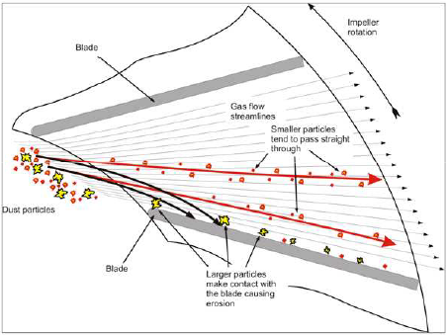
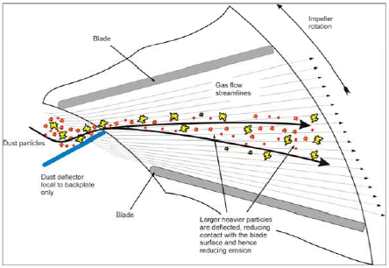
Wear Protection by Particle Deflection
with
without
Deflector

Slide 57
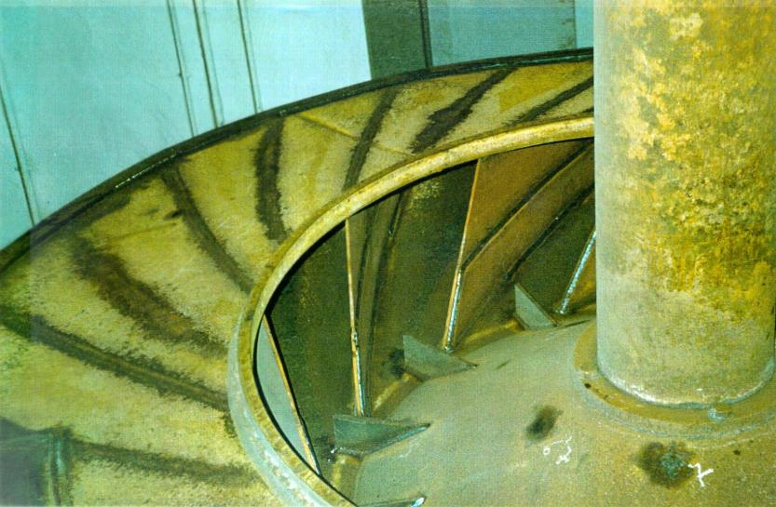
Example of Wear and Deflector Plates
wear plate
deflector plates
57

Slide 58
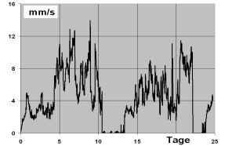
Build-up and Vibrations
Build-Up Root Causes
high gas temperatures (> 350 … 400 °C)
mineralogical composition of raw mix (clay, iron)
high fan speed and high fan inlet velocity
blade-hitting gas/particle flow due to duct/fan design
inappropriate blade shape and angles
dew point problems
Unstable/unbalanced Build-Up leads to Fan Vibrations
increased stress on equipment
reduced lifetime of equipment
increased maintenance required
short interval of kiln stops for fan cleaning
loss of production
increased thermal & electrical power consumption
days
58

Slide 59
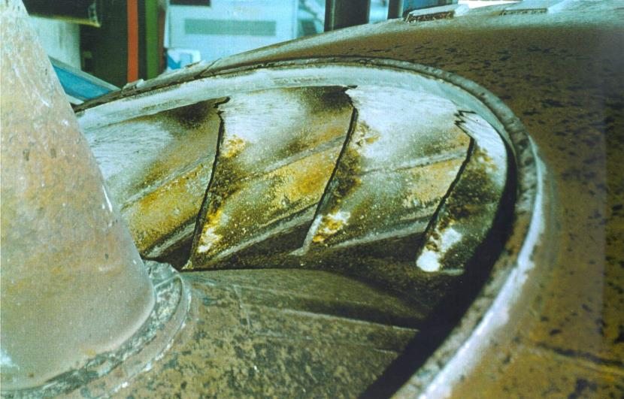
Example of Build-Up
59

Slide 60
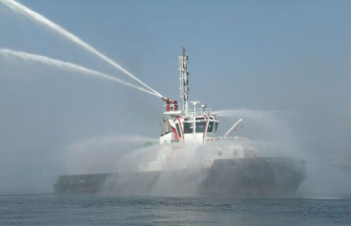
On-Line Fan Cleaning (during operation)
High pressure water spray
Steam injection
Compressed air injection
Sand blasting
Acoustic resonance (ultrasonic)
NOTE: Success of the above methods is difficult to predict! No general recommendation.
60

Slide 61
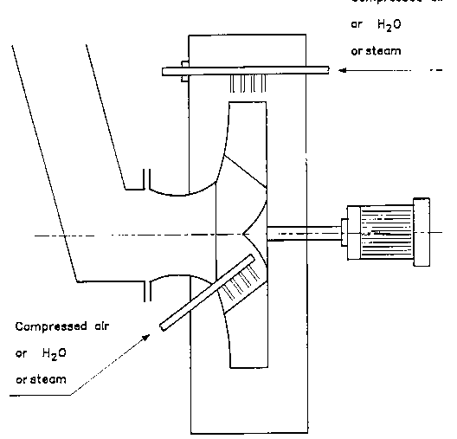
Cracking the dust layer
compressed air water steam
compressed air water steam
61

Slide 62
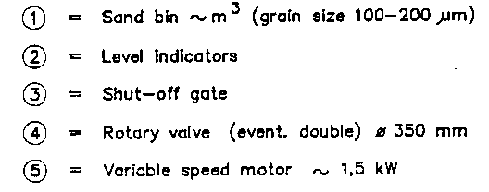
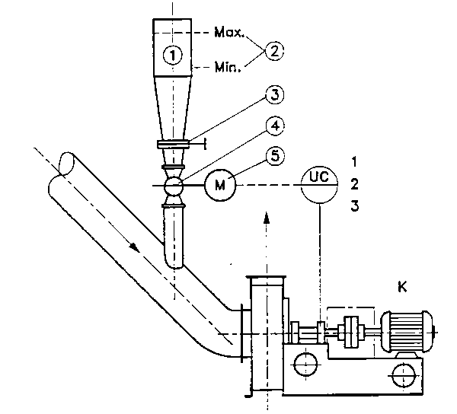
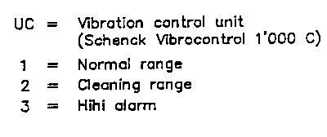
Sand Cleaning Device
Reduce speed during cleaning
62

Slide 63
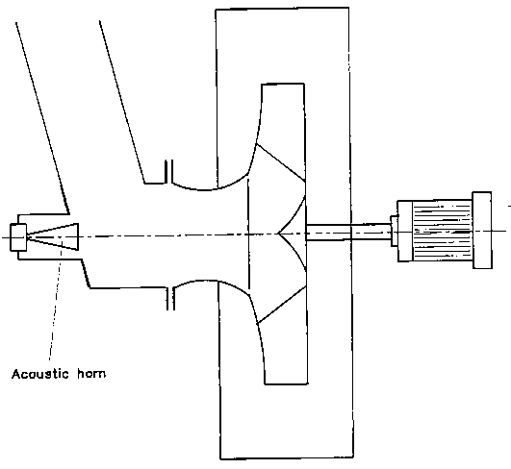
Acoustic Cleaning Devices
acoustic horn
acoustic horn
63

Slide 64
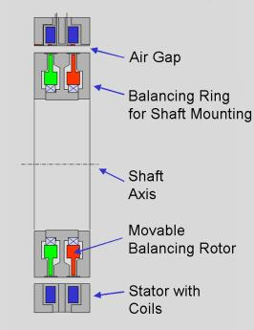
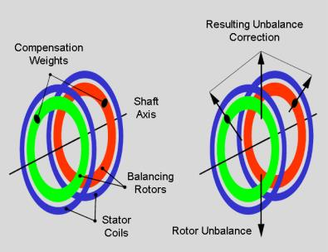
On-Line Active Balancing System
balancing ring (actuator) which is mounted on fan shaft
stator with coils which is mounted concentrically around balancing ring at the bearing housing
actuator contains two identical balancing rotors actuated by coils in the stationary part using stepping motor principle
balancing rotors fixed by magnetic forces
sufficient air gap between the two parts allows for free shaft movement
Source: Hofmann Mess- und Auswuchttechnik GmbH & Co. KG (former: LORD Active Balancing System)
64

Slide 65
On-Line Active Balancing System
https://sites.google.com/a/holcim.com/cp-htec-cm-fani/09-technical-solutions/active-balancing-system
http://www.youtube.com/watch?v=qot5Ydp8Z10

Slide 66
On-Line Active Balancing System
Very positive feedback of competitors’ plants, who suffered from vibrations on kiln ID fans and installed active balancing:
time between fan/kiln stops for cleaning increased from less than 2 months up to one year
vibrations constantly kept below 2 to 5 mm/s
maintenance requirements for the system almost zero
payback period some few months only
In 2009 the active balancing was implemented for the first time in Holcim - at Ambujanagar plant at 3 kiln ID fans:
time between cleaning stops has been more than doubled
payback was some 6 months
zero maintenance
balancer works very reliable and fast
Other references were following within the Group (Höver, Naragong, ...)
On-line active balancing is currently the most promising solution to minimize impact of fan build-up
66

Slide 67

Successful Implementation in Narogong
Installation of autobalancer
Fan cleaned ~ every 2 month
No kiln stop related to fan vibration after installation!

Slide 68
Fan Impeller Tipping
“Simple” solution to increase impeller diameter and as such pressure capacity
Feasibility depends on blade type, impeller geometry, space restrictions, critical fan speed, … ➔ contact your fan supplier
Cheaper than new impeller with correspondingly larger diameter, but in comparison usually with some drawbacks:
lower pressure/flow capacity
lower efficiency
more susceptible to vibrations
Caution! Improper tipping may lead to structural damages and personnel injuries
68

Slide 69
Fan Impeller Replacement
Why?
Poor mechanical condition and/or poor efficiency of existing impeller
Increased flow/pressure capacity required (rate increase, AFR – before concluding: check false air)
Significant change of normal operating point (by WHR, lower PRI…)
Cheaper than complete new fan system, however, potential for higher capacity limited and reduced fan efficiency to be accepted:
Flow capacity ~ + 10%
Pressure capacity ~ + 20%
Efficiency ~ - 3%-points (compared to new system)
Still major modifications required:
housing
inlets
shaft seals
coupling
bearing units including temperature sensors
…
69

Slide 70
Summary
Assessments are needed to know actual fan performance
Reference conditions are crucial to get right conclusions
Wrong documentation will lead to wrong conclusions
Wrong measurements will lead to wrong conclusions
Visual inspection is crucial to find the root causes
Be sure that you have all the data before concluding
Performance will only improve if you work as a team
70

Slide 71


Questions????
Holcim FANi page: https://sites.google.com/a/holcim.com/cp-htec-cm-fani/home
71

Slide 73
The right Fan Design is crucial for fan performance
Consider p, V and P reserves on expected operating points
e.g. kiln ID fan (new line): 30% flow, 30% pressure, 10% power
choose appropriate fan accuracy class
Consider the right gas temperature and density
consider peak operating temperatures: lifetime, interlock
design gas density: dust, T, O₂, CO₂, H₂O
Choose the appropriate fan blade design
consider dust, build-up risk, efficiency
use aerofoil blades only for clean gas applications
Use VSD with direct connection of motor and fan
Prefer larger impeller diameter, lower max fan speed
< 1‘000 rpm for large fans; < 3‘600 rpm for e.g. clinker cooler cooling air fans
1st critical fan speed minimum 150% of max fan speed
Check fan curve (surge, motor and speed limits)
Do workshop inspection
73

Slide 74

Location of pressure measurement planes for site testing
We specify conditions at (4) and (8) dynamic differences are ignored because of same/similar gas velocities in ducts
1a
Supplier typically specifies conditions at (1)/(1a) and (2)/(2a) and sometimes ignores losses from (4) to (1a) and from (2a) to (8)
2a
(1a = impeller inlet)
(2a = fan outlet)
Source of drawing: ISO 5802

Slide 75

Measured vs Expected – Example (Fan Efficiency Tool results)
Δp_{M} = 19.6 mbar
V_{E} = 256’029 m³/h = 71.1 m³/s
P_{E} = 169 kW
From Fan Curves
(at Shaft)
Δp_{M}
Δp_{M} = 19.6 mbar
V_{E}
From Process Measurements
V_{M} = 185’427 m³/h = 51.5 m³/s
P_{M} = 190 kW
(at VSD)
η_{VSD} = 97.5 %
η_{Cable} = 99.5 %
η_{Motor} = 96.5 %
η_{Coupling} = 100 %
P_{E}
P_{M,S} = 182 kW (at Shaft)
V_{E}

Slide 76



Graphical Representation of Results - Example
Error “Areas” overlapping?
Yes → Acceptable
No → Not Acceptable
Error Bars from Measurement Accuracy
Error Bars from Accuracy Class

Slide 77
Conclusions
Findings
Moderate to high flow deviation (-18 to 0%)
High efficiency deviation (-26 to -13%)
High power deviation (18%)
Possible causes
False air not considered?
Measurement location
Damaged impeller, casing or cone?
Worn out blades
Cones not properly adjusted
Notes:
First, we have to gather the findings:
The fan is delivering much lower flow than expected
The efficiency is poor
And the fan is consuming more power than expected but it’s still inside the tolerance.
What could be the root causes?
The first one is that we didn’t consider FA for the assessment, there might be a big source of false air from the measuring point to the fan outlet
The fan is working at 60% of the max fan speed, this can create an error because of the calculation method, which we cannot really avoid but we should be aware of and it can create also a high efficiency drop, not following the rule of the “constant” efficiency for VSD anymore.
The third preliminary conclusion we can get (without checking the fan itself) is that there might be some damages on the impeller, like wear or a problem with the gap adjustment.

Slide 78



Recommendations
Check impeller
Inlet cone / impeller gap
Inlet cone penetration
Impeller conditions (wear, deformation…)
Crosscheck measured flow
Measure at inlet and outlet
Consider false air from measuring point(s) to fan inlet/outlet
Notes:
And these would be the recommendations we can make out of the conclusions from the tool results.
Check the impeller and cross check the measured data
In this case, we found out that the impeller conditions were quite good, but there was a significant amount of false air coming in. When we remade the calculation considering this “extra” flow, we found out that the efficiency of the fan is actually good and that the problem is not on the impeller but on the ducting.
Final message, before suggesting to change the fan, make sure you don’t have another problem that is much cheaper and easier to fix.

